Slide 1

Generating State-Based Syntax Highlighters from Rascal’s context-free grammars
By Edser Apperloo
Supervisors:
Tijs van der Storm
&
Mircea Lungu

Slide 2
State-based syntax highlighters
Similar to state machines
Contexts
Matches
Scopes

Slide 3
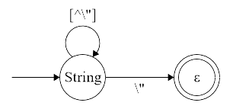
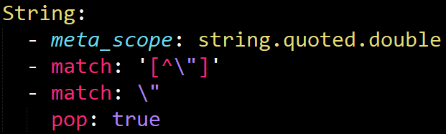
State-based syntax highlighters
Contexts -> States
Matches -> Transitions
Scopes -> Colouring

Slide 4
The designed algorithm in Rascal
How to embed highlighter information?
Simplify grammars
Transform to strongly regular grammars
To component machines
Translation to a syntax highlighter

Slide 5
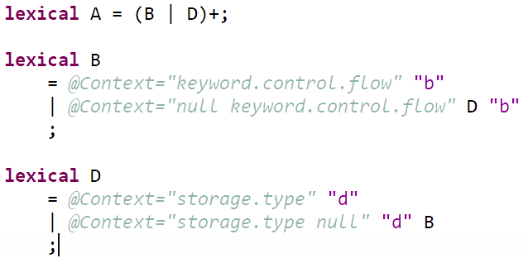
The original grammar
Example sentences:
“bbddbdb”
“bdbdbd”
@Context=“storage.type”
@Context=“null storage.type”

Slide 6
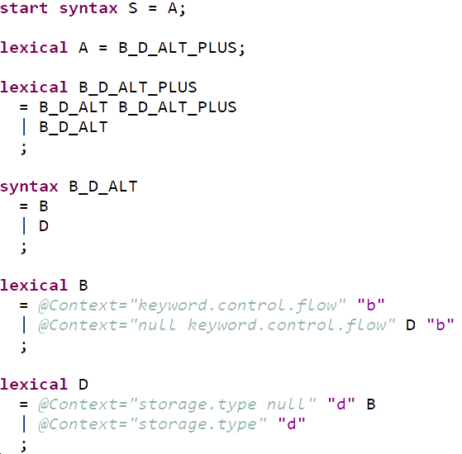
The plain version
Rewritten regular tokens
Reduced to \prod(_,_,_)

Slide 7
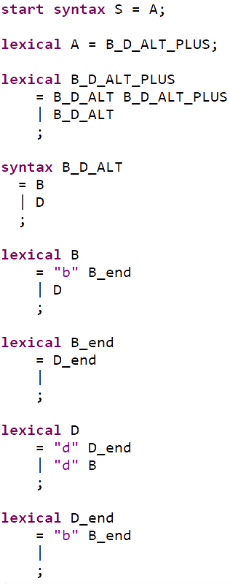
Strongly regular version
Mohri and Nederhof
Transforms any CFG into a strongly regular approximation
Mutually recursive non-terminals

Slide 9
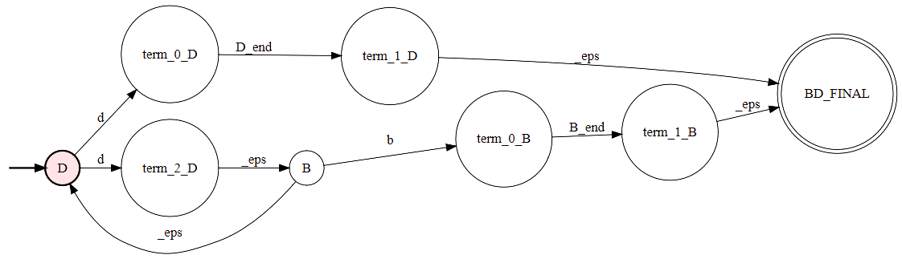
Component machines
One machine per strongly connected component
Compact representation
NFA for “lexical D”

Slide 10
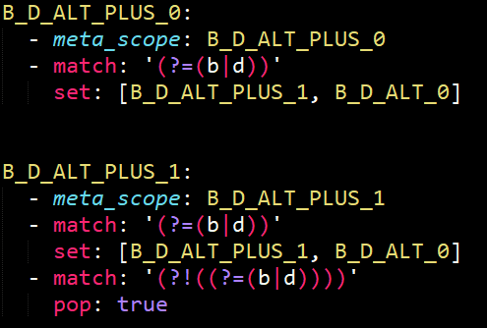
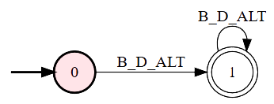
Mapping to Highlighter
Almost direct mapping

Slide 11
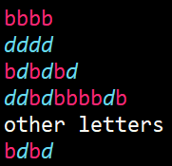
Results & Evaluation
Performance and resulting highlighter
11 Contexts
~100 SLOC
Reasons for errors:
Conflicts
End-of-line characters ($)
Parser like behavior
Lost possibility to handle nested structures like comments

Slide 12
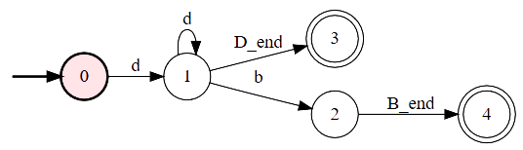
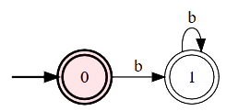
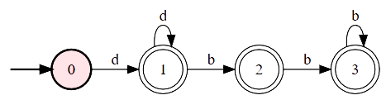
Conflict resolution
Original DFA for D
DFA for B_end
New DFA for D
DFA for D_end

Slide 13
Results & Evaluation
Reasons for errors:
Conflicts and how these are solved
End-of-line characters ($)
Parser like behavior
Lost possibility to handle nested structures like comments

Slide 14
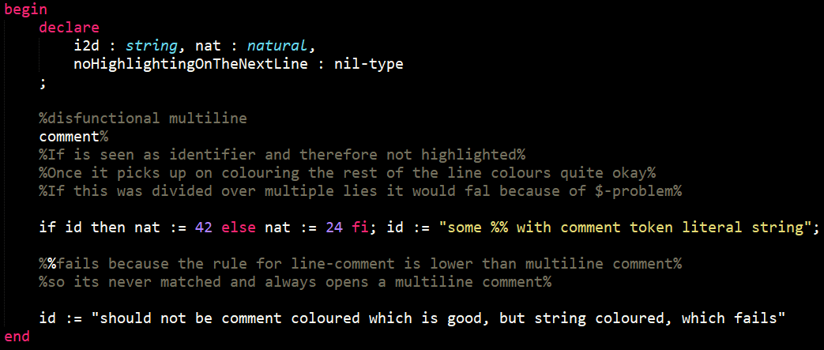
Results & Evaluation

Slide 15
Results & Evaluation
Reasons for errors:
Conflicts and how these are solved
End-of-line characters ($)
Parser like behavior
Lost possibility to handle nested structures like comments

Slide 16
Conclusion
Promising at first
Severity of errors
Wrong approach
Suggestions for future work
Different information embedding
Retain less of the structure

